Slide 1

Digital Signage Solution using AWS Elemental MediaLive
P.KUSUMITHA (2210030423)
Under the esteemed guidance of
Ms. P. Sree Lakshmi
Assistant Professor,
Department of Computer Science and Engineering

Slide 2
Project Overview
1.Problem / Opportunity
Traditional signage systems rely on manual updates or dedicated hardware.
Content updates are slow, especially across distributed locations.
High cost of maintenance and limited scalability.
2.Objective
Develop a cloud-native digital signage system that is cost-effective, scalable, and centrally manageable.
Use Amazon S3 for static content storage and CloudFront for global content delivery.
3.Real-World Relevance
Instant content updates for advertisements, event info, announcements.
Supports retail, educational institutions, airports, and more.
Low-latency access across multiple locations worldwide.

Slide 3
Services Used
1. Amazon S3
Durable, highly available object storage.
Hosts HTML/CSS/JS content for signage.
Supports versioning and lifecycle rules for content rotation.
2. Amazon DynamoDB
Content Delivery Network (CDN) for global delivery.
Caches signage content at edge locations for low latency.
Reduces origin load and ensures fast, consistent performance.

Slide 4
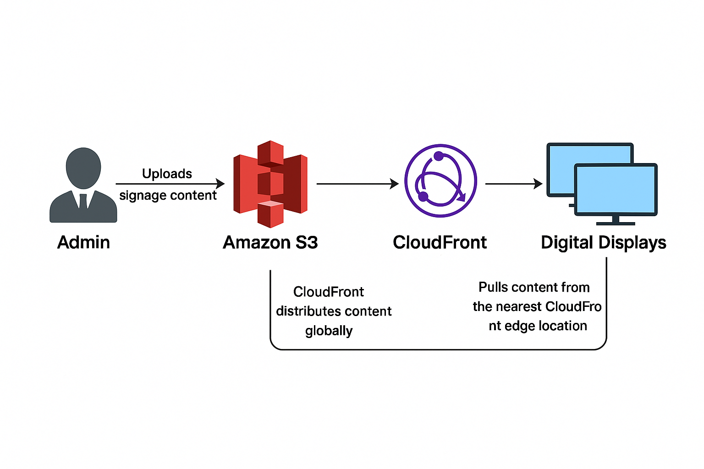
Flow Diagram

Slide 5
Implementation Process
1. Setup S3 Bucket
Enable static website hosting.
Set proper bucket policies for public read or authenticated access.
2. Upload Signage Content
HTML/CSS/JS files or multimedia assets (images, videos).
Use S3 Versioning for rollback or scheduled updates.
3. Configure CloudFront
Set origin to S3 bucket.
Enable caching, compression, and SSL.
Use invalidation for instant content refresh.
4. Deploy to Screens
Use web browsers or custom apps to load content via CloudFront URLs

Slide 6
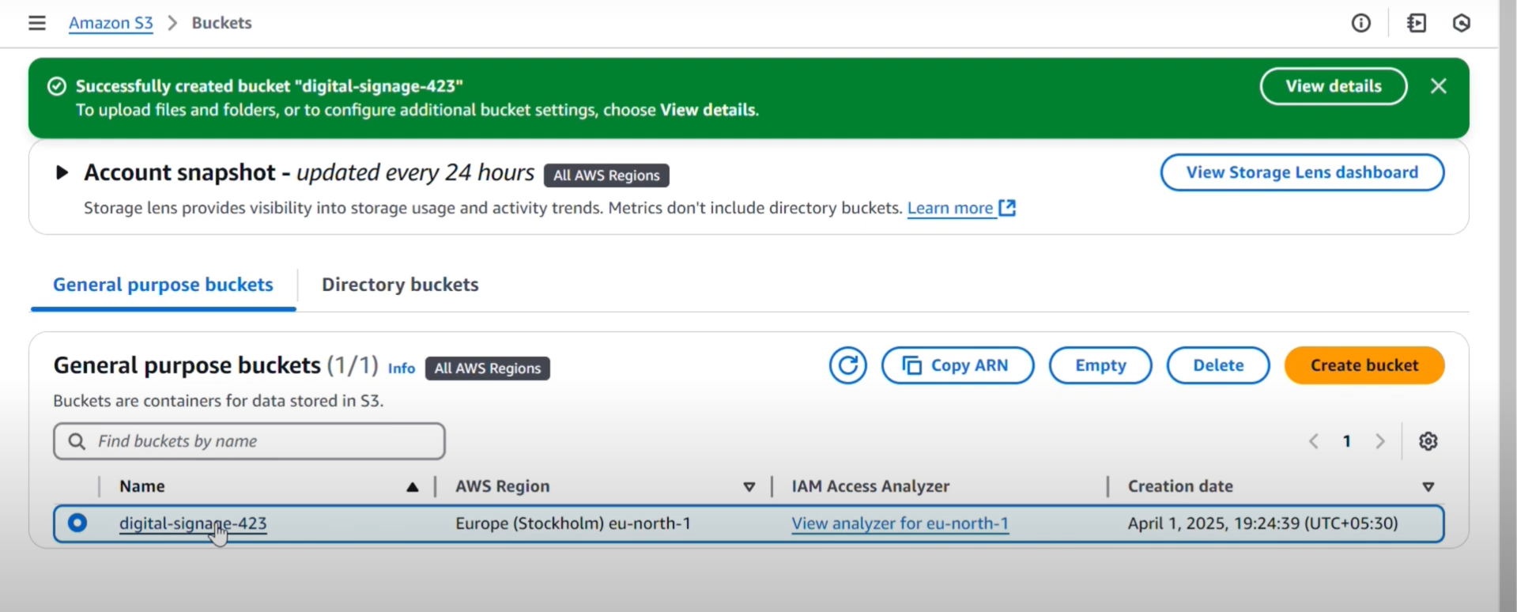
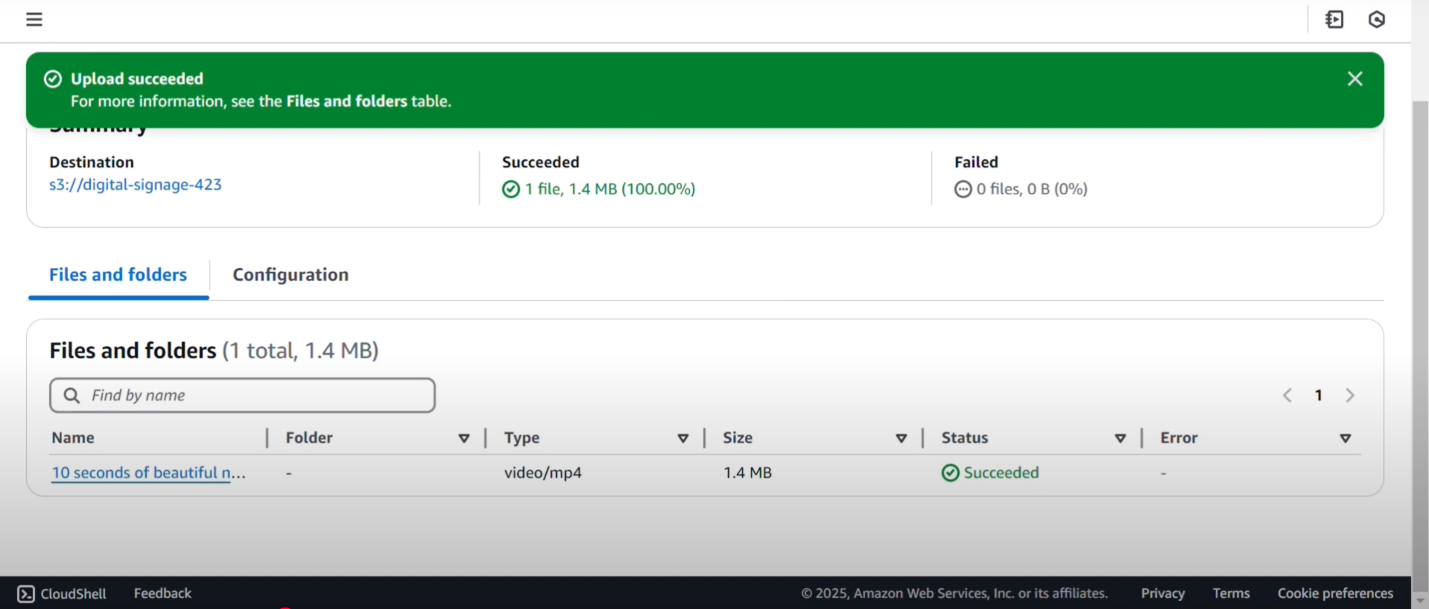
Implementation Process

Slide 7
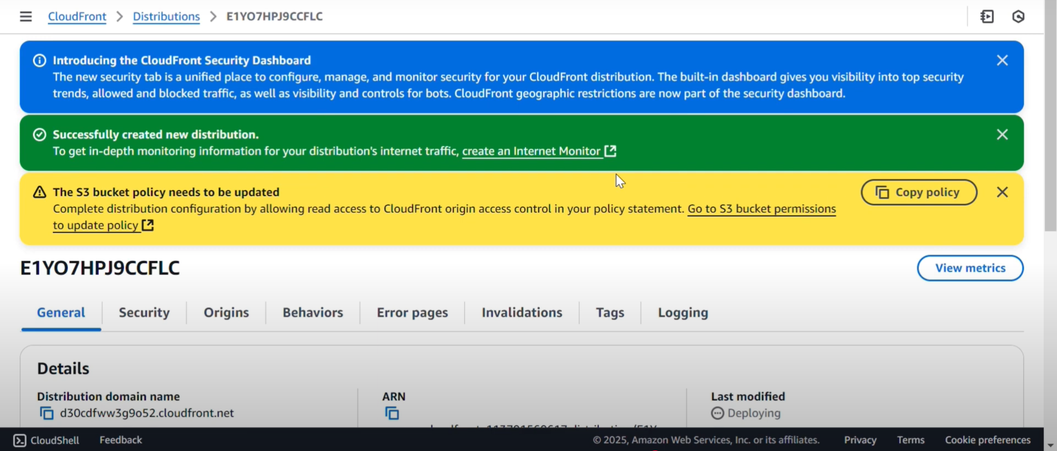
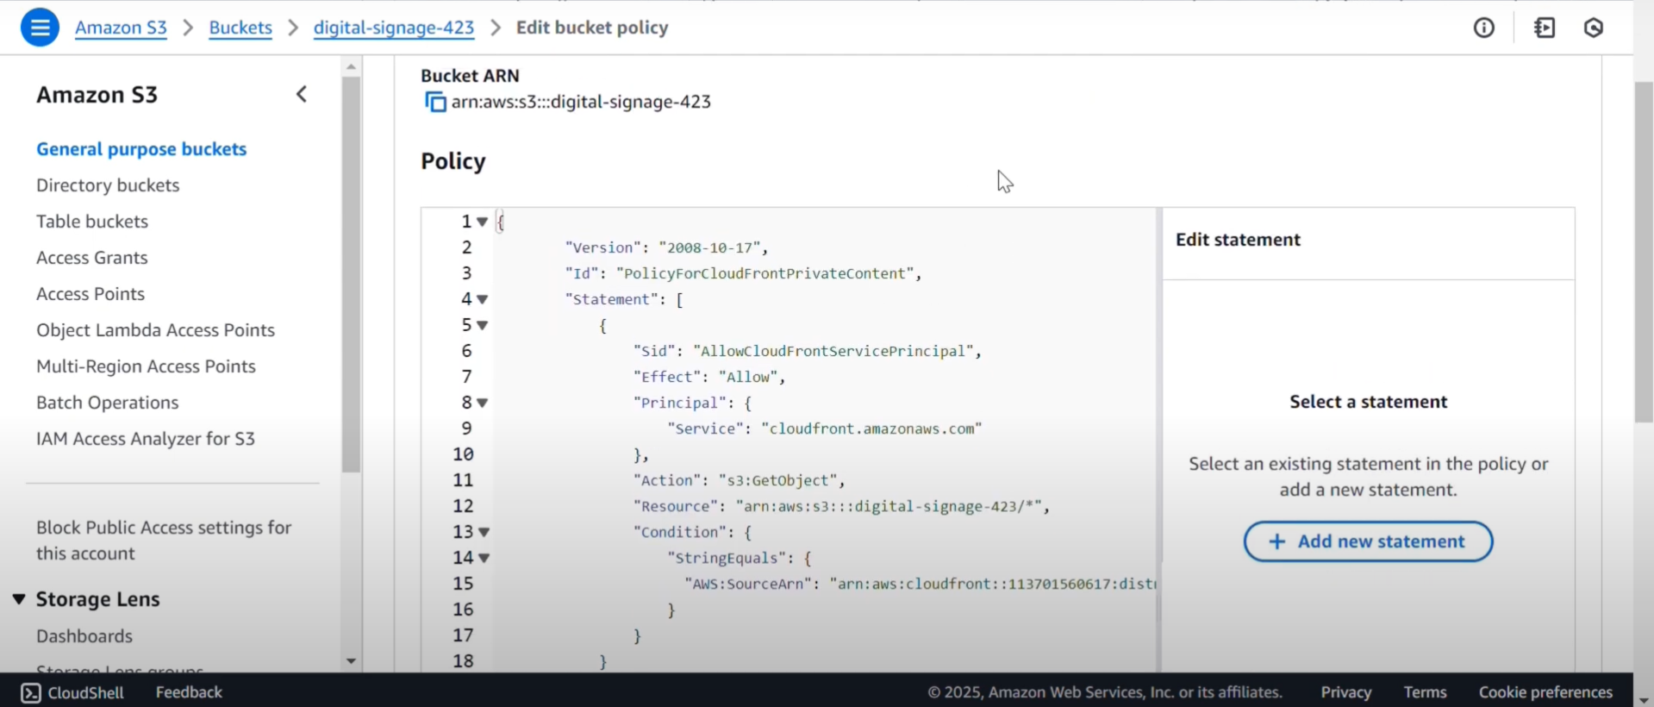
Implementation Process

Slide 8
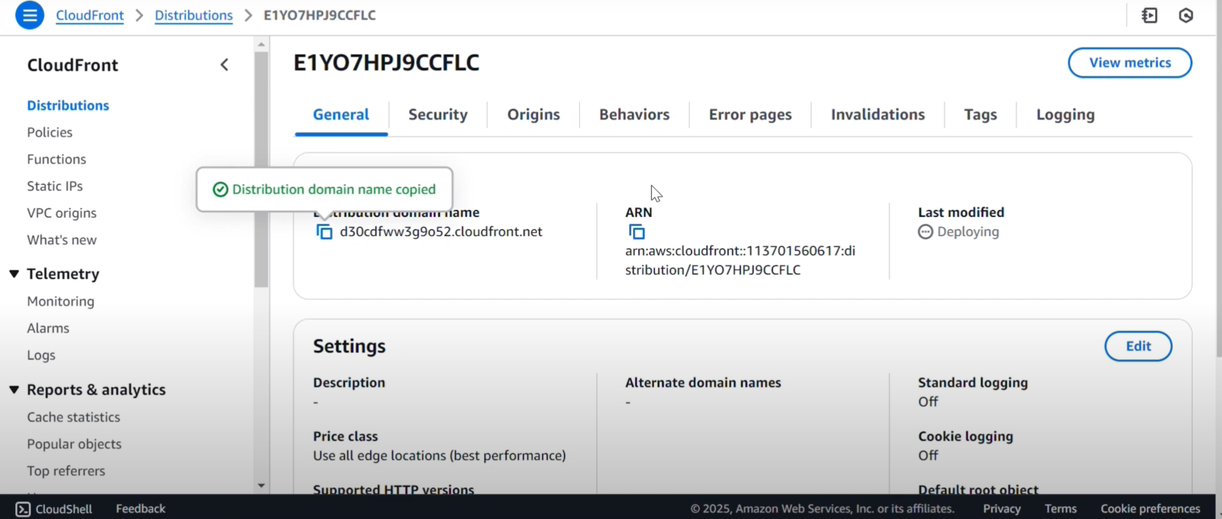
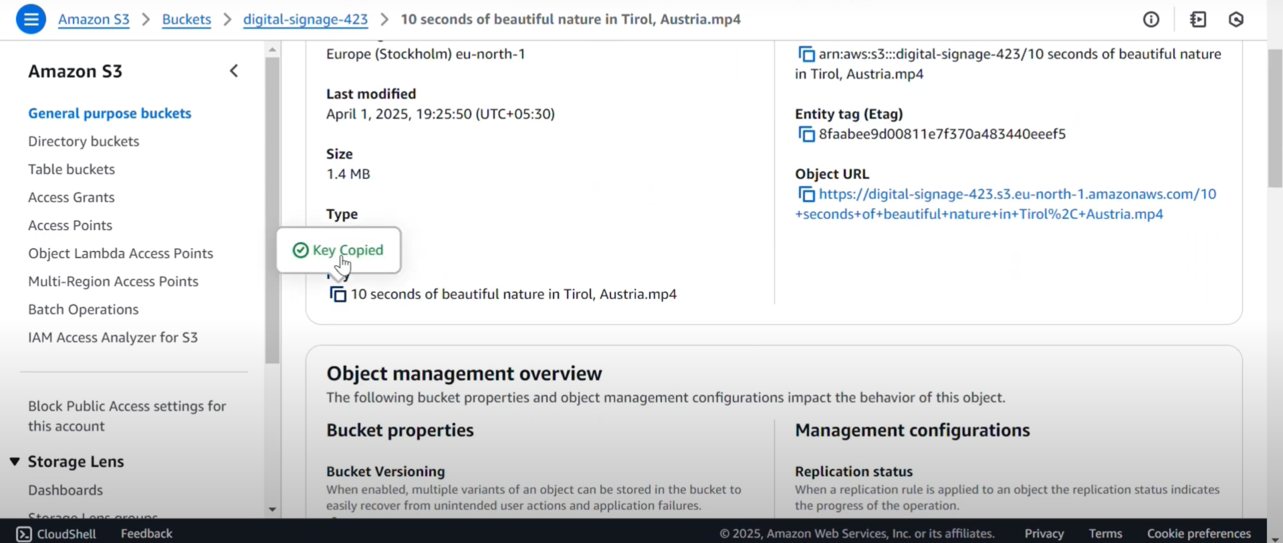
Implementation Process

Slide 9
Key Features and Functionality
Instant Content Delivery using CDN CloudFront ensures signage content is delivered from the nearest edge location, reducing latency and improving load times globally.
Centralized Management All signage files (HTML, images, videos) are managed from a single S3 bucket, allowing easy updates and consistency across displays.
Scalable Architecture Supports thousands of digital displays without any architectural change. Whether in one location or across continents, content scales seamlessly.
Offline Fallback Browser-based caching ensures that in case of network interruptions, the last version of the signage continues to display.

Slide 10
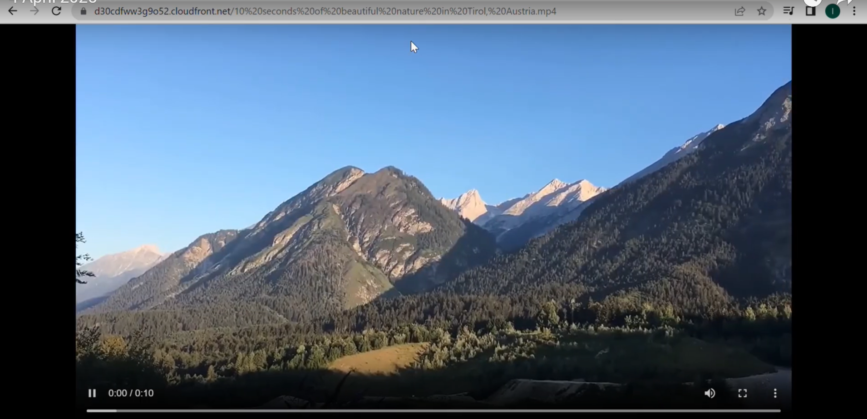
Results and Outputs

Slide 11
Challenges and Solutions
Content Delay due to Cache
Use CloudFront invalidations to instantly refresh outdated content.
Set Cache-Control headers to define content expiration and revalidation rules.
Security of Signage Content
Apply S3 bucket policies to restrict access.
Use Signed URLs or Signed Cookies with CloudFront to control who can access content.
Version Management
Enable S3 Object Versioning to maintain historical versions of signage content.
Use Lifecycle Policies to automate cleanup of outdated or unused content.

Slide 12
Learnings & Takeaways
1.Technical Skills
Set up S3 Static Website Hosting for efficient content delivery.
Configure CloudFront CDN for low-latency global access.
Apply IAM Policies to secure and manage access to AWS resources.
2.Soft Skills
Wrote clear and concise project documentation.
Automated content workflows using cloud-native tools.
3. Certifications
Working towards AWS Certified Developer – Associate

Slide 13
Future Scope
Deploy across multiple AWS regions with failover routing.
1.Possible Extensions/Improvements
Develop a secure admin portal with role-based authentication.
Multi-platform Support (mobile apps)
2. Real-Time Deployment Considerations
Scalability:Use CloudFront’s global edge network + S3.
High Availability: Deploy across multiple AWS regions with failover routing.
3.Cost Optimization/Scaling Ideas
Use S3 and CloudFront for serverless, low-maintenance hosting.
Cache wisely using CloudFront TTLs to reduce origin fetches.
Leverage AWS Free Tier and lifecycle rules for cost control.

Slide 14
References
[1] Amazon Web Services (AWS). "Getting Started with AWS Elemental MediaLive." Available at: https://aws.amazon.com/medialive/getting-started/
[2] Amazon Web Services (AWS). "AWS Elemental MediaLive User Guide." Available at: https://docs.aws.amazon.com/medialive/
[3] Amazon Web Services (AWS). "Tutorial: How to Stream Video on Demand with AmazonS3 and CloudFront." Available at: https://aws.amazon.com/blogs/media/streaming-video-on-demand-with-amazon-cloudfront/
[4] Amazon Web Services (AWS). "Live Streaming with AWS Elemental MediaLive and MediaPackage." Available at: https://aws.amazon.com/blogs/media/live-streaming-with-aws-elemental-medialive-and-mediapackage/
[5] Amazon Web Services (AWS)."Getting Started with Amazon CloudFront." Available at: https://docs.aws.amazon.com/AmazonCloudFront/latest/DeveloperGuide/GettingStarted.html

Slide 15
THANK YOU

